Slide 1

Machine Learning
FTW Batch 8
Week 8
Notes:
Machine learning is about extracting knowledge from data. It is a research field at the
intersection of statistics, artificial intelligence, and computer science and is also
known as predictive analytics or statistical learning. The application of machine
learning methods has in recent years become ubiquitous in everyday life. From automatic
recommendations of which movies to watch, to what food to order or which
products to buy, to personalized online radio and recognizing your friends in your
photos, many modern websites and devices have machine learning algorithms at their
core. When you look at a complex website like Facebook, Amazon, or Netflix, it is
very likely that every part of the site contains multiple machine learning models.
Outside of commercial applications, machine learning has had a tremendous influence
on the way data-driven research is done today. The tools introduced in this book
have been applied to diverse scientific problems such as understanding stars, finding
distant planets, discovering new particles, analyzing DNA sequences, and providing
personalized cancer treatments.
Your application doesn’t need to be as large-scale or world-changing as these examples
in order to benefit from machine learning, though. In this chapter, we will
explain why machine learning has become so popular and discuss what kinds of
problems can be solved using machine learning. Then, we will show you how to build
your first machine learning model, introducing important concepts along the way.

Slide 2
Review

Slide 3

What topics have we covered so far?
What are your biggest learnings / takeaways?
Intro to DS
Data management
Data prep
Data viz
Statistics
EDA
Linear Regression
Notes:
Intro to DS
Data management
Data prep
Data viz
Statistics
EDA

Slide 4
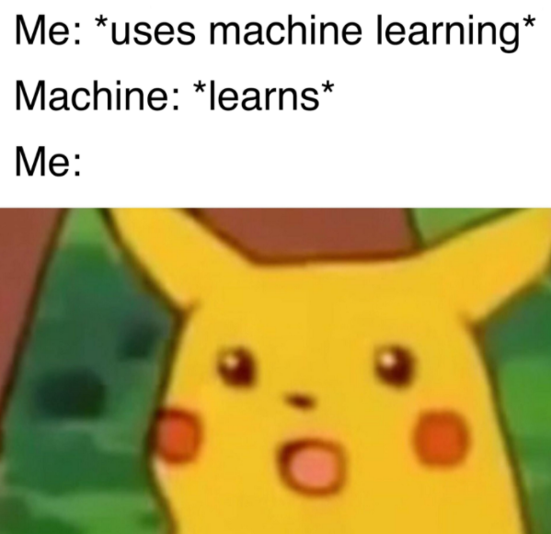
Linear Regression Code Example Review
Notes:
Each square shows the correlation between the variables on each axis. Correlation ranges from -1 to +1. Values closer to zero means there is no linear trend between the two variables. The close to 1 the correlation is the more positively correlated they are; that is as one increases so does the other and the closer to 1 the stronger this relationship is. A correlation closer to -1 is similar, but instead of both increasing one variable will decrease as the other increases. The diagonals are all 1/dark green because those squares are correlating each variable to itself (so it's a perfect correlation). For the rest the larger the number and darker the color the higher the correlation between the two variables. The plot is also symmetrical about the diagonal since the same two variables are being paired together in those squares.
univariate distribution of data i.e. data distribution of a variable against the density distribution. The y-axis in a density plot is the probability density function for the kernel density estimation. However, we need to be careful to specify this is a probability density and not a probability. The difference is the probability density is the probability per unit on the x-axis.

Slide 5

Group Work and Presentations

Slide 6
Linear Regression Hands-On Exercise: Ecommerce
Your client is an Ecommerce company based in New York City that sells clothing online but they also have in-store style and clothing advice sessions.
Customers come in to the store, have sessions/meetings with a personal stylist, then they can go home and order either on a mobile app or website for the clothes they want.
The company is trying to decide whether to focus their efforts on their mobile app experience or their website. They've hired you on contract to help them figure it out!
Complete the guided notebook and feel free to include additional EDA steps
Explore the relationship between 'Avg. Session Length', 'Time on App','Time on Website', 'Length of Membership' and 'Yearly Amount Spent', using linear regression.
Based on the result in #2, do you think the company should focus more on their mobile app or on their website?
Please work with your groups and share your findings in a brief presentation.
https://github.com/angelaaaateng/ftw_python/blob/main/Linear_Regression_Exercise_B8.ipynb
Notes:
https://colab.research.google.com/drive/1flxRZRvtonukJU8O-rDCl5k7Er6RWzpz?authuser=6#scrollTo=zPdspz2RRXQj
https://colab.research.google.com/drive/11hVfQnLBXdnM9MaJomfg2T4Fh8mvjJEY?authuser=6#scrollTo=GzBOIqG_LJXy

Slide 7

Will you click on this ad? (Yes/No)

Slide 8
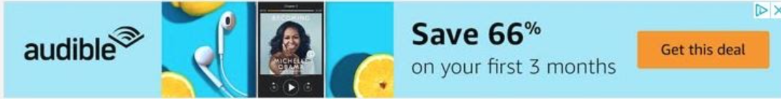
Will you click on this ad? (Yes/No)

Slide 9
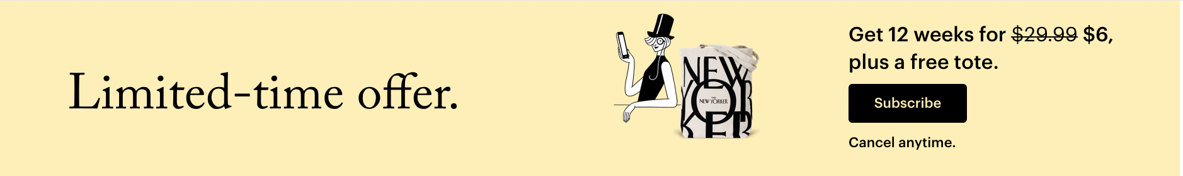
Will you click on this ad? (Yes/No)

Slide 10

Will you click on this ad? (Yes/No)

Slide 11

Will you click on this ad? (Yes/No)

Slide 12
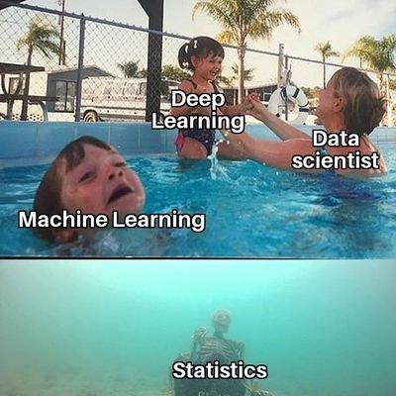
Classification

Slide 13
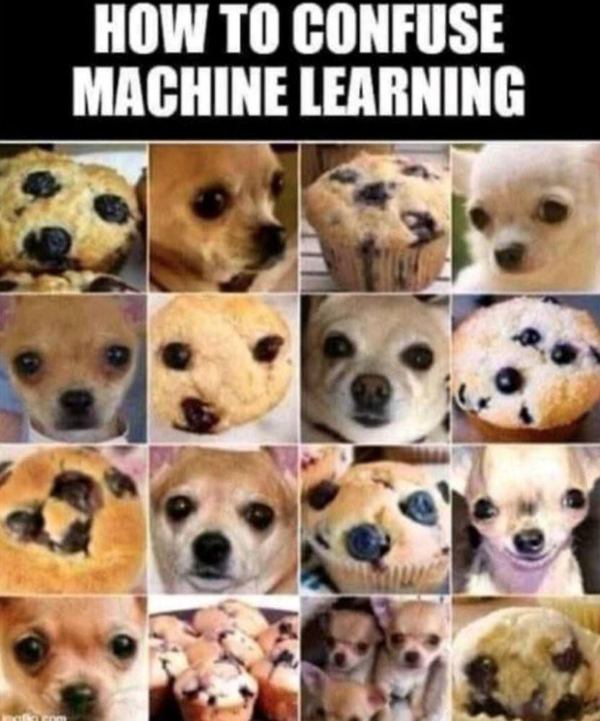
Classification
Samples belong to two or more classes and we want to learn from already labeled data how to predict the class of unlabeled data.
Notes:
An example of a classification problem would be handwritten digit recognition, in which the aim is to assign each input vector to one of a finite number of discrete categories. Another way to think of classification is as a discrete (as opposed to continuous) form of supervised learning where one has a limited number of categories and for each of the n samples provided, one is to try to label them with the correct category or class.
Linear regresiosn - house prices

Slide 14
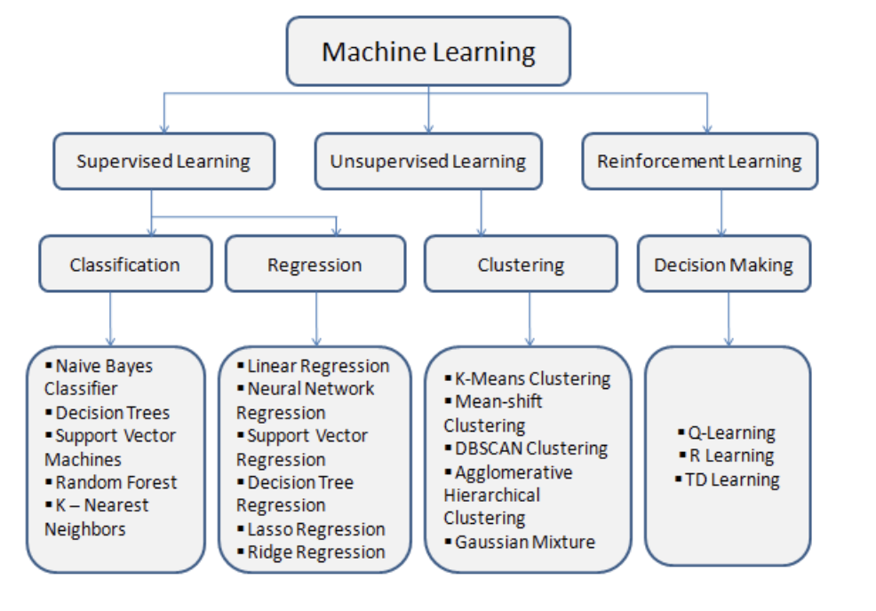
Classification
Notes:
ISLR Section 4
Logistic regression as a method for classification
What categories things belong to
Problems solved by Classification
Simple Classification Techniques - Logistic Regression
Classification Metrics
Model-Based Feature Selection
Advance Modelling Techniques

Slide 15
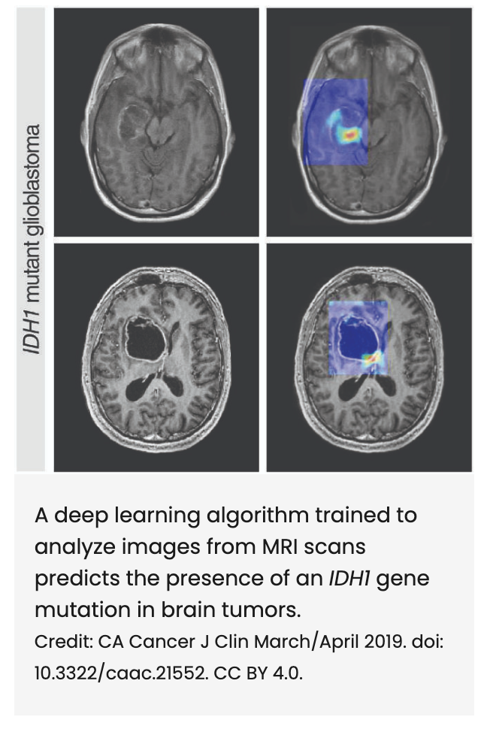
Problems Solved by Classification
We want to learn about Logistic Regression as a method for Classification.
Although the name may be confusing at first, logistic regression allows us to solve classification problems, where we are trying to predict discrete categories.
The convention for binary classification is to have two classes 0 and 1.
Notes:
● So far we’ve only seen regression problems where we try to
predict a continuous value. (price of a house)
● Although the name may be confusing at first, logistic
regression allows us to solve classification problems, where
we are trying to predict discrete categories.
● The convention for binary classification is to have two
classes 0 and 1.
Some examples of classification problems:
Spam versus “Ham” emails
Loan Default (yes/no)
Disease Diagnosis
Above were all examples of Binary Classification
Disease detection (cardiovascular, sleep, etc),
Image recognition, image segmentation, object detection,
Click-through prediction, churn modelling.
Fraud detection (credit cards, etc),
Event prediction (predict next app use case, predict next website click)

Slide 16
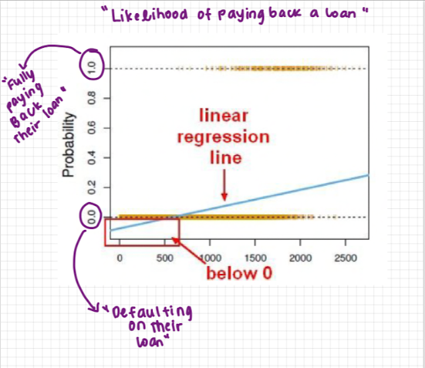
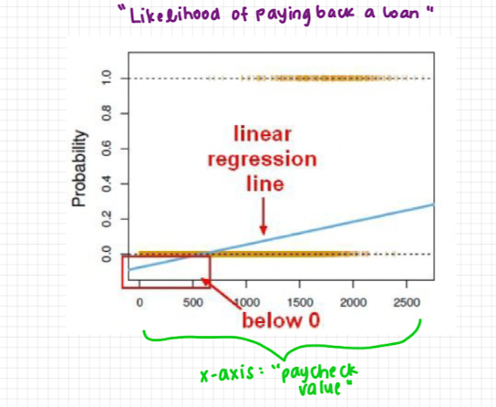
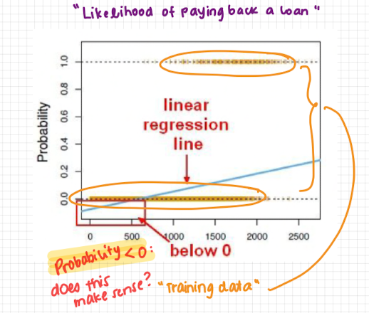
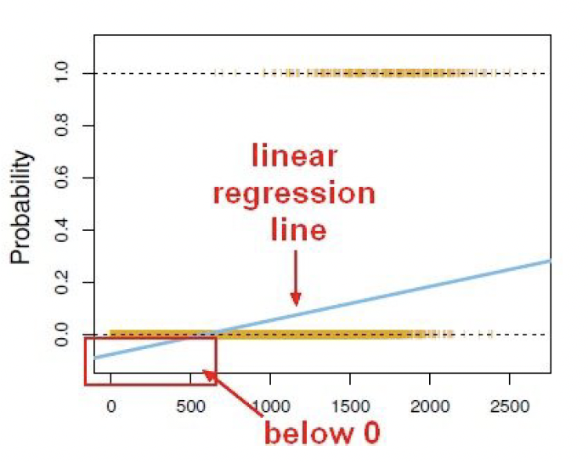
Logistic Regression
We can’t use a normal linear regression model on binary groups. It won’t lead to a good fit.
Notes:
So far, we’ve seen linear regression applied in the context of predicting house prices
What does it mean to get a probability less than 0 if our target value is discrete? It’s not really meaningful. Even though the model spits out a result, it might not be relevant or meaningful.
Imagine that this example plot is trying to predict the probability / likelihood of paying back a loan
0% probability is defaulting on the loan (meaning 0% probability of paying back the loan)
X axis = paycheck value
As your paycheck goes lower, you have lower likelihood of paying back your loans
Yellow dashes = training data
Likelihood of paying back a loan
0 % probability of paying back a loan
X axis - paycheck value

Slide 17
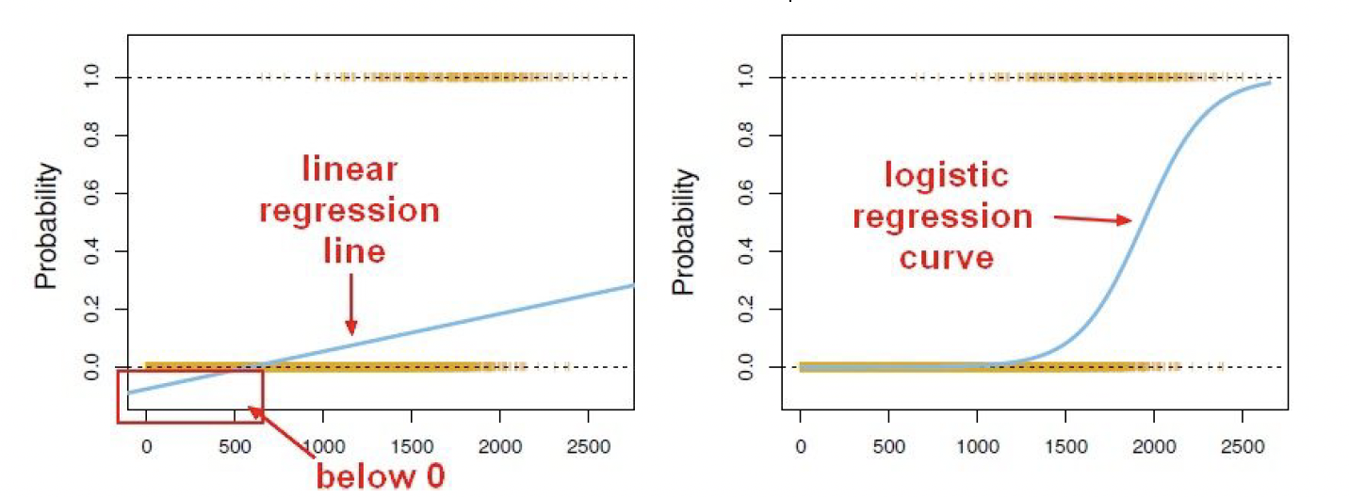
Logistic Regression
Notes:
Instead we can transform our linear regression to a logistic
regression curve.
Logistic regression curve can only go from 0 or 1
Sigmoid = logistic function
To do linear modelling on outcomes that are binary, we need a link function that maps the REAL SPACE (as input) into the PROBABILITY SPACE [0, 1]:

Slide 18
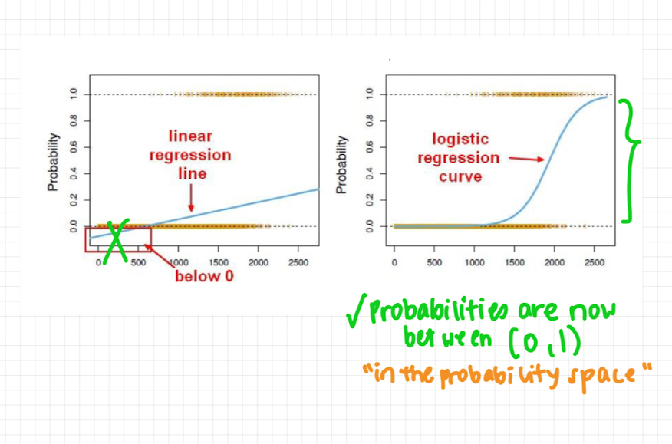
Logistic Regression
Notes:
Instead we can transform our linear regression to a logistic
regression curve.
Logistic regression curve can only go from 0 or 1
Sigmoid = logistic function
To do linear modelling on outcomes that are binary, we need a link function that maps the REAL SPACE (as input) into the PROBABILITY SPACE [0, 1]:

Slide 19
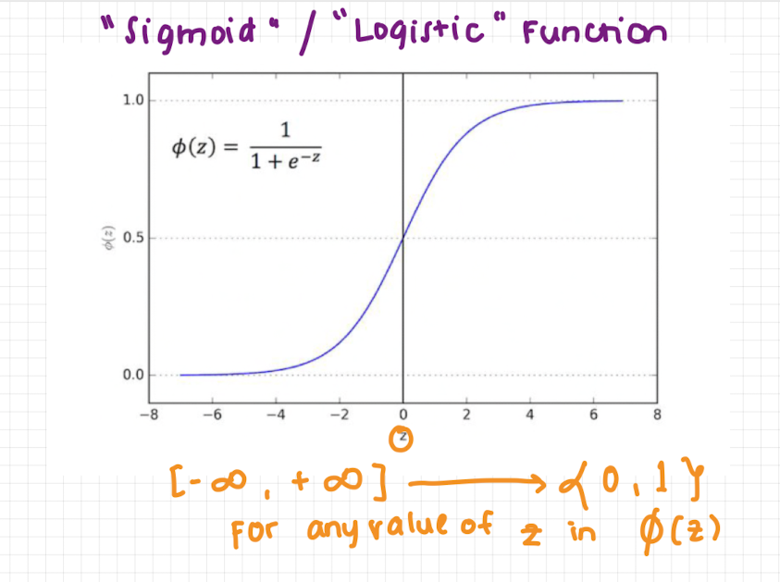
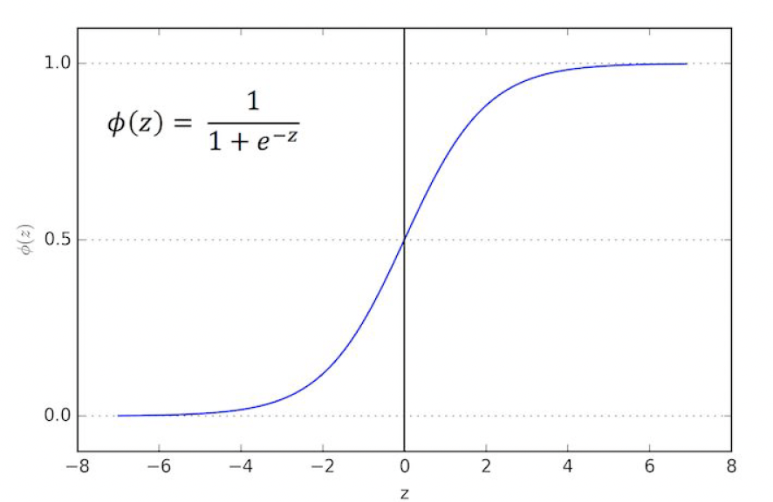
Logistic Regression
Notes:
The key secret to this function is that it can take in any value and its output is going to be between 0 and 1.
Instead we can transform our linear regression to a logistic regression curve.
The Sigmoid (aka Logistic) Function takes in any value and outputs it to be between 0 and 1
This means we can take our Linear Regression Solution and place it into the Sigmoid Function
This results in a probability from 0 to 1 of belonging in the 1 class.
This means that we can take her linear regression solution and place it into this sigmoid function and that's going to look like this.
Remember our linear model followed a basic y equals x plus B principle.
Here we have a linear model as y equals beta plus Beta 1 times X..
If we take that linear model and put it into the sigmoid function we finally are able to transform this linear regression to a logistic model meaning it doesn't matter whatever the value of the linear model output actually is.
It's always going to be between 0 and 1 when we place it into the logistic model or the sigmoid function
This results in a probability from 0 to 1 of belonging in the 1 Class.
This means that we can take her linear regression solution and place it into this sigmoid function and that's going to look like this.
Remember our linear model followed a basic y equals x plus B principle.
Here we have a linear model as y equals beta plus Beta 1 times X..
If we take that linear model and put it into the sigmoid function we finally are able to transform this linear regression to a logistic model meaning it doesn't matter whatever the value of the linear model
output actually is.
It's always going to be between 0 and 1 when we place it into the logistic model or the sigmoid function
This results in a probability from 0 to 1 of belonging in the 1
class.
The Sigmoid (aka Logistic) Function takes in any value and outputs it to be between 0 and 1
This means we can take our Linear Regression Solution and place it into the Sigmoid Function
This means that we can take her linear regression solution and place it into this sigmoid function and
that's going to look like this.
Remember our linear model followed a basic y equals x plus B principle.
Here we have a linear model as y equals beta plus Beta 1 times X..
If we take that linear model and put it into the sigmoid function we finally are able to transform this
linear regression to a logistic model meaning it doesn't matter whatever the value of the linear model
output actually is.
It's always going to be between 0 and 1 when we place it into the logistic model or the sigmoid function
MAIN POINT: take linear model and use it as input into sigmoid function, then we get a transformation
So we’ve turned our linear regression model into a logistic regression model

Slide 20
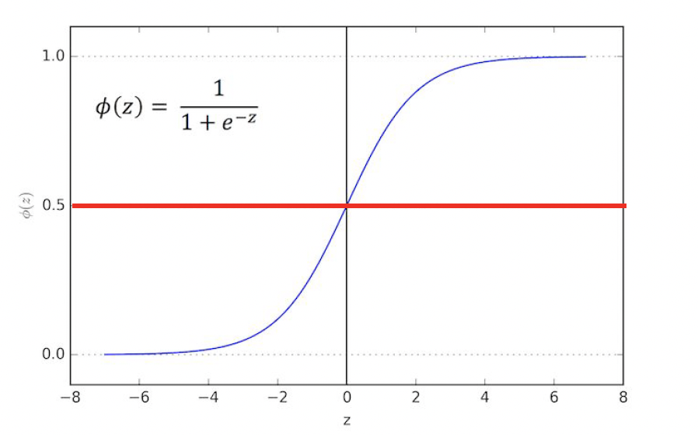
Logistic Regression
Notes:
This results in a probability from 0 to 1 of belonging in the 1
Class.
Easy to implement and can be used as the baseline for any binary classification problem.
We use the logistic function to output a value ranging from 0 to 1. Based off of this probability we assign a class.
We can set a cutoff point at 0.5, anything below it results in class 0, anything above is class 1
Input values (x) are combined linearly using weights or coefficient values to predict a categorical output value (y).

Slide 21
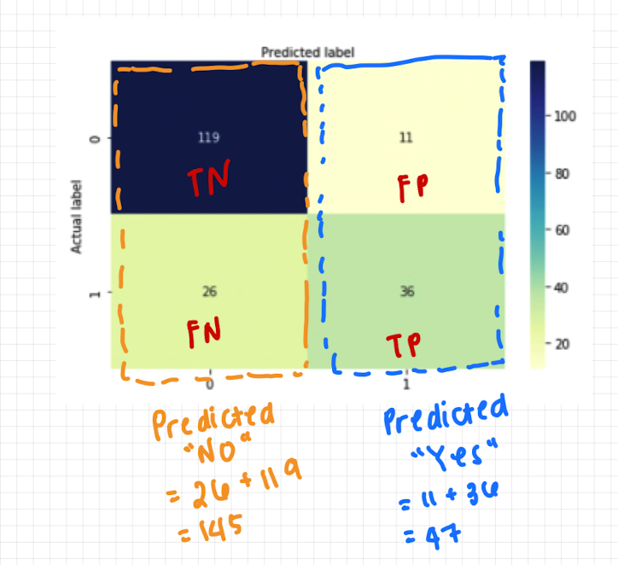
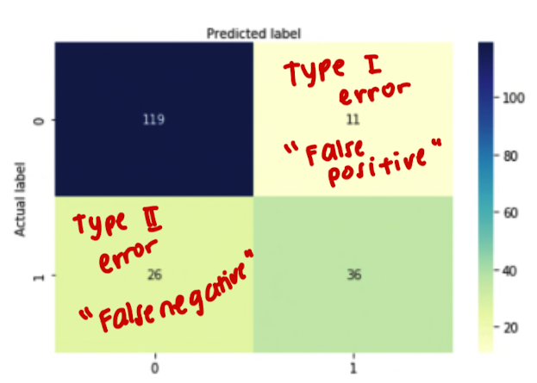
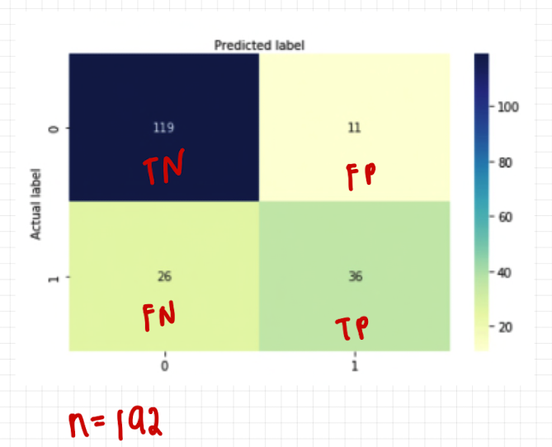
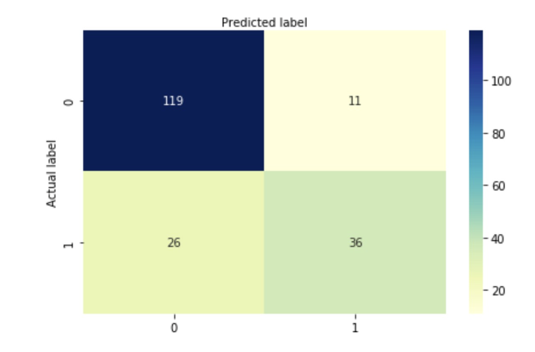
Logistic Regression: Model Evaluation (Confusion Matrix)
Notes:
● After you train a logistic regression model on some training
data, you will evaluate your model’s performance on some
test data.
● You can use a confusion matrix to evaluate classification
models.
Let's go ahead and walk through this example.
In this case we have a binary classification problem.
So in this example we're testing for the presence of a disease where no is a negative test which is
false equals zero.
Yes is a positive test where true is equal to one.
What can we learn from this matrix.
Well there are two possible predicted classes.
Yes and no.
If we were predicting the presence of a disease for example yes it would mean that they have disease.
No it would mean that they don't have disease.
The classifier made a total of a hundred and sixty five predictions meaning 165 patients were tested
for the presence of the disease.
Out of those 165 cases the classifier predicted a yes 110 times and no.
Fifty five times.
In reality meaning we already have label test data 105 patients in the sample have the disease and 60
patients do not.
Confusion Matrix:
Number of correct and incorrect predictions are summed up class-wise.
Diagonal values represent accurate predictions, while non-diagonal elements are inaccurate predictions.
metrics.confusion_matrix(y_test, y_pred)

Slide 22

Logistic Regression: Model Evaluation
Notes:
● After you train a logistic regression model on some training
data, you will evaluate your model’s performance on some
test data.
● You can use a confusion matrix to evaluate classification
models.

Slide 23
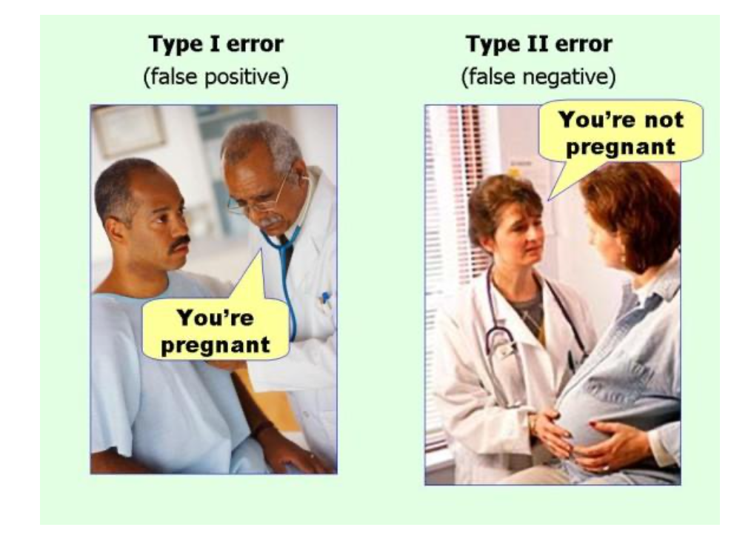
Logistic Regression: Model Evaluation
Notes:
● After you train a logistic regression model on some training
data, you will evaluate your model’s performance on some
test data.
● You can use a confusion matrix to evaluate classification
Models.
A high value of C tells the model to give high weight to the training data, and a lower weight to the complexity penalty. A low value tells the model to give more weight to this complexity penalty at the expense of fitting to the training data. Basically, a high C means "Trust this training data a lot", while a low value says "This data may not be fully representative of the real world data, so if it's telling you to make a parameter really large, don't listen to it".

Slide 24
Activity: Pinoy Henyo!
B8
Notes:
Machine learning is about extracting knowledge from data. It is a research field at the
intersection of statistics, artificial intelligence, and computer science and is also
known as predictive analytics or statistical learning. The application of machine
learning methods has in recent years become ubiquitous in everyday life. From automatic
recommendations of which movies to watch, to what food to order or which
products to buy, to personalized online radio and recognizing your friends in your
photos, many modern websites and devices have machine learning algorithms at their
core. When you look at a complex website like Facebook, Amazon, or Netflix, it is
very likely that every part of the site contains multiple machine learning models.
Outside of commercial applications, machine learning has had a tremendous influence
on the way data-driven research is done today. The tools introduced in this book
have been applied to diverse scientific problems such as understanding stars, finding
distant planets, discovering new particles, analyzing DNA sequences, and providing
personalized cancer treatments.
Your application doesn’t need to be as large-scale or world-changing as these examples
in order to benefit from machine learning, though. In this chapter, we will
explain why machine learning has become so popular and discuss what kinds of
problems can be solved using machine learning. Then, we will show you how to build
your first machine learning model, introducing important concepts along the way.

Slide 25

Ano ang spending habits ng mga mall customers na ‘to?

Slide 26

Ano ang spending habits ng mga mall customers na ‘to?

Slide 27

Ano ang spending habits ng mga mall customers na ‘to?

Slide 28

Ano ang spending habits ng mga mall customers na ‘to?

Slide 29
Clustering
Week 9

Slide 30
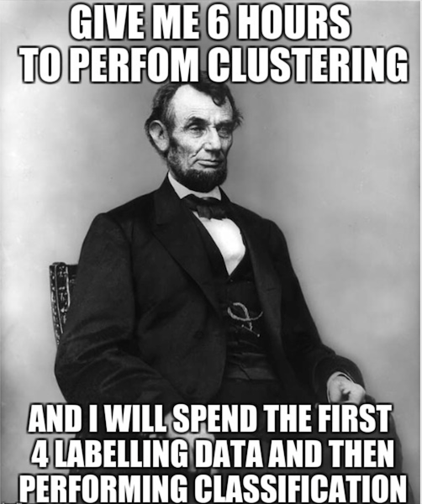
Clustering
Cluster analysis or clustering is the task of grouping a set of objects in such a way that objects in the same group (called a cluster) are more similar to each other than to those in other groups (clusters).
Notes:
It is a main task of exploratory data mining, and a common technique for statistical data analysis, used in many fields, including pattern recognition, image analysis, information retrieval, bioinformatics, data compression, computer graphics and machine learning.

Slide 31
Clustering
Problems solved by Clustering
Simple Clustering Techniques
Choosing Clusters
Advanced Modelling Techniques

Slide 32
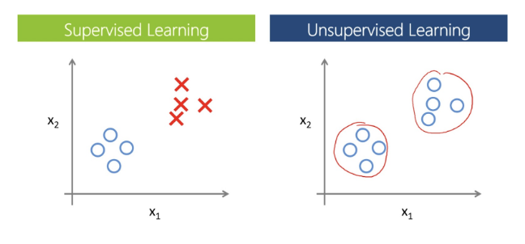
Problems Solved by Clustering

Slide 33
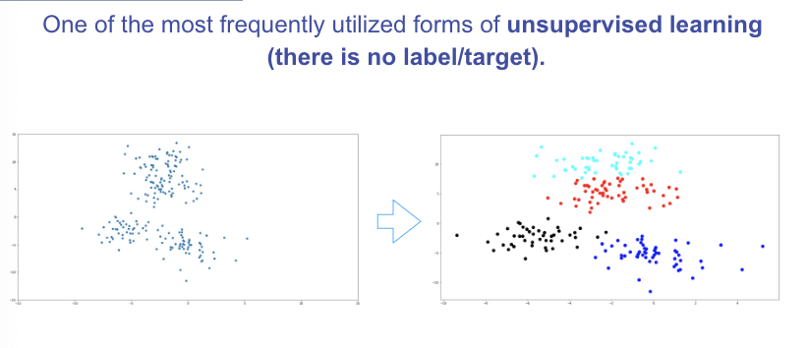
Problems Solved by Clustering
Fake news detection
Label-less fraud detection
Spam filtering
Document analysis

Slide 34
K-Means Clustering
K Means Clustering is an unsupervised learning algorithm that will attempt to group similar clusters together in your data.
So what does a typical clustering problem look like?
● Cluster Similar Documents
● Cluster Customers based on Features
● Market Segmentation
● Identify similar physical groups
Notes:
ISLR Ch10
Unlabeled data

Slide 35
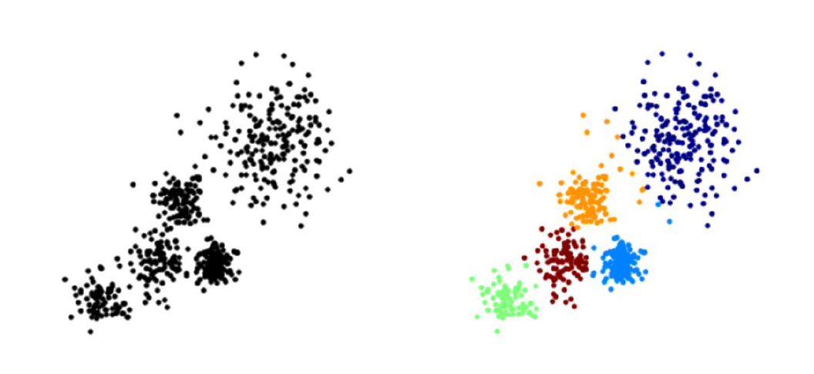
K-Means Clustering
The overall goal is to divide data into distinct groups such that observations within each group are similar
Notes:
Here you can see a diagram of unlabelled training data and k means clustering trying to attempt to cluster
that data into five distinct clock colored clusters here.

Slide 36
K-Means Clustering
The K Means Algorithm
● Choose a number of Clusters “K”
● Randomly assign each point to a cluster
● Until clusters stop changing, repeat the following:
○ For each cluster, compute the cluster centroid by
taking the mean vector of points in the cluster
○ Assign each data point to the cluster for which the
centroid is the closest
Notes:
How does the algorithm actually work.
Well you first choosing a number of clusters K and we'll discuss how to choose k later on then you randomly
assign each point in your data to a specific cluster then until the clusters stop changing.
You repeat the following steps for each cluster you're going to compute the cluster centroid by taking
the mean vector points in the cluster.
Then you assign each data point to the cluster for which the centroid is the closest.
Let's go ahead and take a look at the state of visualization or this plotted out visualization of k

Slide 37
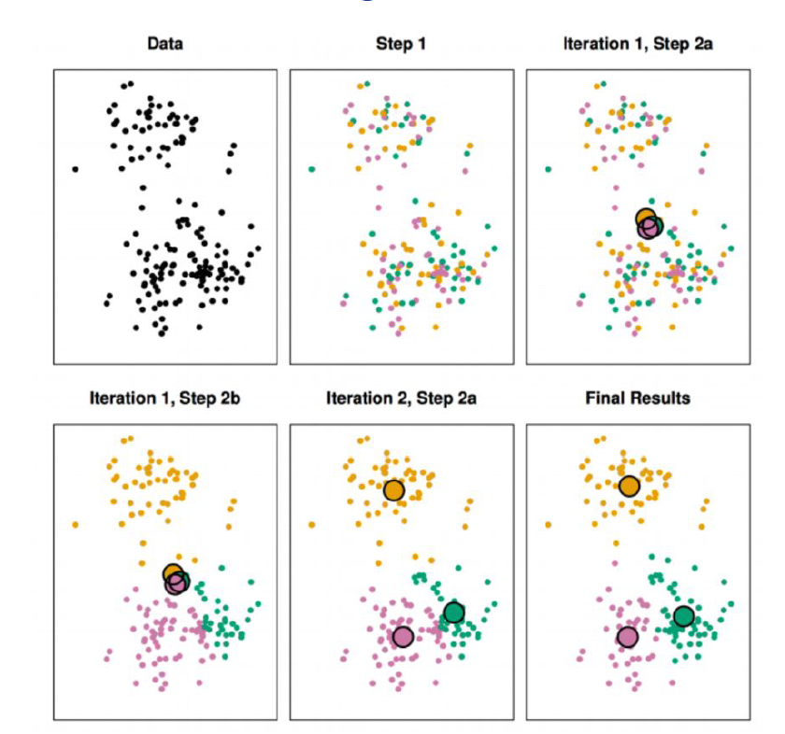
K-Means Clustering
Notes:
You first start off with just the observations that's shown on the top left then in top center we have
Step 1 of the algorithm.
Each observation is randomly assigned to a cluster in the top right of step 2 A The cluster centroid
are then computed.
These are shown as large colored disks.
Initially these centroid are almost completely overlapping because the initial cluster assignments were
chosen at random in the bottom left.
And step two be each observation is assigned to the nearest centroid in the bottom center.
Step two is once again perform and you can see that we've led to a new cluster centroid and we basically
keep repeating these steps until there's no new clusters meaning data points aren't being reassigned
to a new cluster centroid at the bottom right.
We have the results obtained after about 10 iterations.

Slide 38
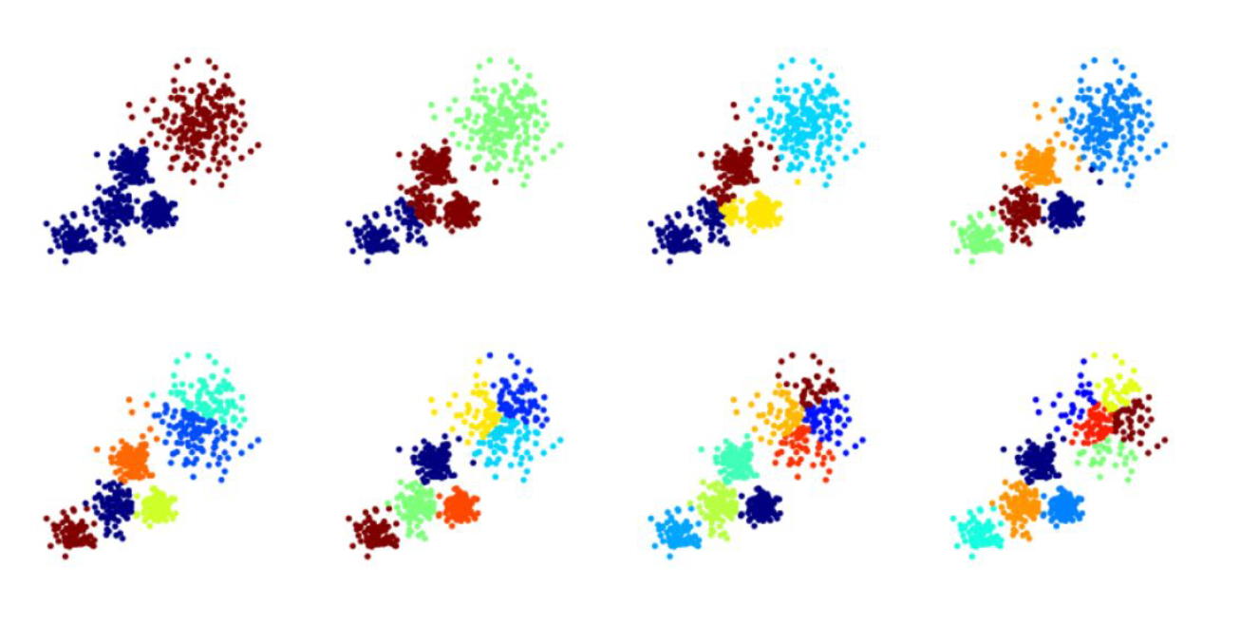
K-Means Clustering
Notes:
Let's discuss choosing a k value as we just saw to perform k means clustering.
We have to decide how many clusters we expect in the data.
The problem of selecting K isn't actually that simple.
There is no easy answer for choosing a best case value.

Slide 39
K-Means Clustering
There is no easy answer for choosing a “best” K value
One way is the elbow method
First of all, compute the sum of squared error (SSE) for some values of k (for example 2, 4, 6, 8, etc.).
The SSE is defined as the sum of the squared distance between each member of the cluster and its centroid.
If you plot k against the SSE, you will see that the error decreases as k gets larger; this is because when the number of clusters increases, they should be smaller, so distortion is also smaller.
The idea of the elbow method is to choose the k at which the SSE decreases abruptly.
This produces an "elbow effect" in the graph, as you can see in the following picture:

Slide 40
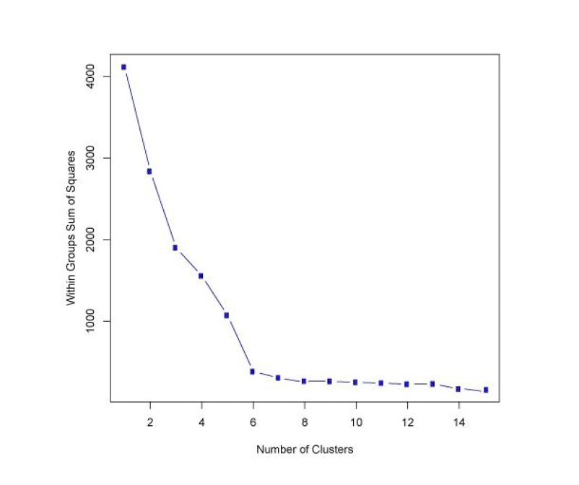
K-Means Clustering

Slide 41
Using LLMs as coding copilots
LLMs are also trained on code, which means you can use it to generate programming code snippets based on prompts. Here are some tips:
Be Specific: Provide clear details, code snippets, and your programming language.
Test, Understand, Validate: Don't blindly use suggestions; test and check them.
Iterate, Refine, Show examples: Engage in back-and-forth conversations for improvement. Use code examples to illustrate what you are looking for.
Seek Best Practices: Ask for coding standards and process workflow
Combine with Research: Use ChatGPT alongside your own knowledge and research.
Make the most of ChatGPT as a coding copilot while ensuring that your coding process remains effective and educational. As always, be careful of hallucinations!
Notes:
https://machinelearningmastery.com/a-gentle-introduction-to-hallucinations-in-large-language-models/
In the context of LLMs, “hallucination” refers to a phenomenon where the model generates text that is incorrect, nonsensical, or not real. Since LLMs are not databases or search engines, they would not cite where their response is based on. These models generate text as an extrapolation from the prompt you provided. The result of extrapolation is not necessarily supported by any training data, but is the most correlated from the prompt.
https://www.mygreatlearning.com/blog/prompt-engineering-complete-guide/#:~:text=Prompt%20engineering%20involves%20crafting%20precise,shape%20its%20behavior%20and%20output.

Slide 42
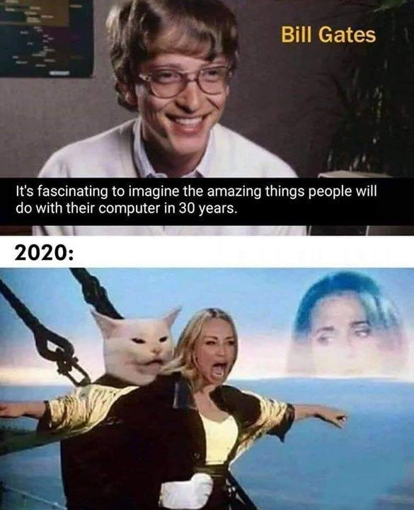
Group Work and Mini-Capstone
https://raw.githubusercontent.com/angelaaaateng/ftw_python/main/data/titanic_train_demo.csv

Slide 43
Titanic Dataset
What model did you use and why?
Share some basic EDA and data visualizations on the dataset
What questions do you have about the dataset? Is there anything you would want to explore further? What questions would you ask your “domain expert”?
What do your predictions look like? Does it make sense?
How did your model perform? (from what we’ve seen so far in class)
Data dictionary: https://www.kaggle.com/competitions/titanic/data
Dataset: https://raw.githubusercontent.com/angelaaaateng/ftw_python/main/data/titanic_train_demo.csv
Notes:
https://machinelearningmastery.com/a-gentle-introduction-to-hallucinations-in-large-language-models/
In the context of LLMs, “hallucination” refers to a phenomenon where the model generates text that is incorrect, nonsensical, or not real. Since LLMs are not databases or search engines, they would not cite where their response is based on. These models generate text as an extrapolation from the prompt you provided. The result of extrapolation is not necessarily supported by any training data, but is the most correlated from the prompt.
https://www.mygreatlearning.com/blog/prompt-engineering-complete-guide/#:~:text=Prompt%20engineering%20involves%20crafting%20precise,shape%20its%20behavior%20and%20output.

Slide 44
Thank you :)

